Slide 1
Coal Transportation by Rail – Outlook for Rates and Service
Presentation to:
NEMS/AEO Annual Conference
Energy Information Administration, March 12, 2002
Presented by:
Stan Kaplan
PA Consulting Group
Washington, DC
202-442-2553 stan.kaplan@paconsulting.com

Slide 2
Agenda
  Background –Rail, Coal and Power
  The Rail Industry – Running into a Dead End?
  Railroad Business Strategy
  Implications for Coal and Power

Slide 3
Background – Rail, Coal and Power

Slide 4
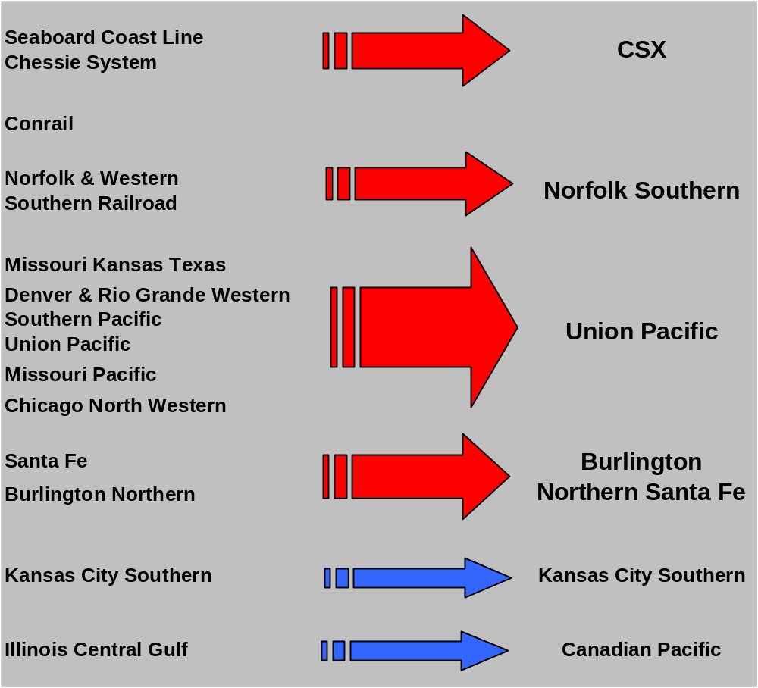
The Railroad Implosion

Slide 5
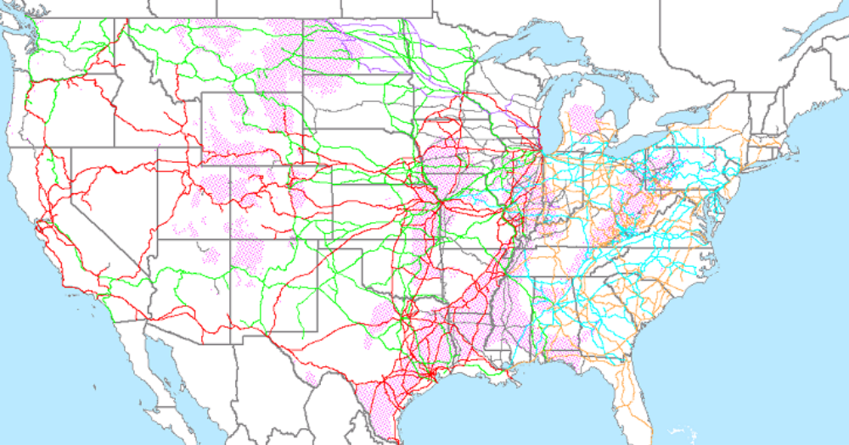


Rail Network and Coal Fields
Dominant in the West:
UP and BNSF
Dominant in the East:
CSX and NS
Map from RDI PowerMap

Slide 6
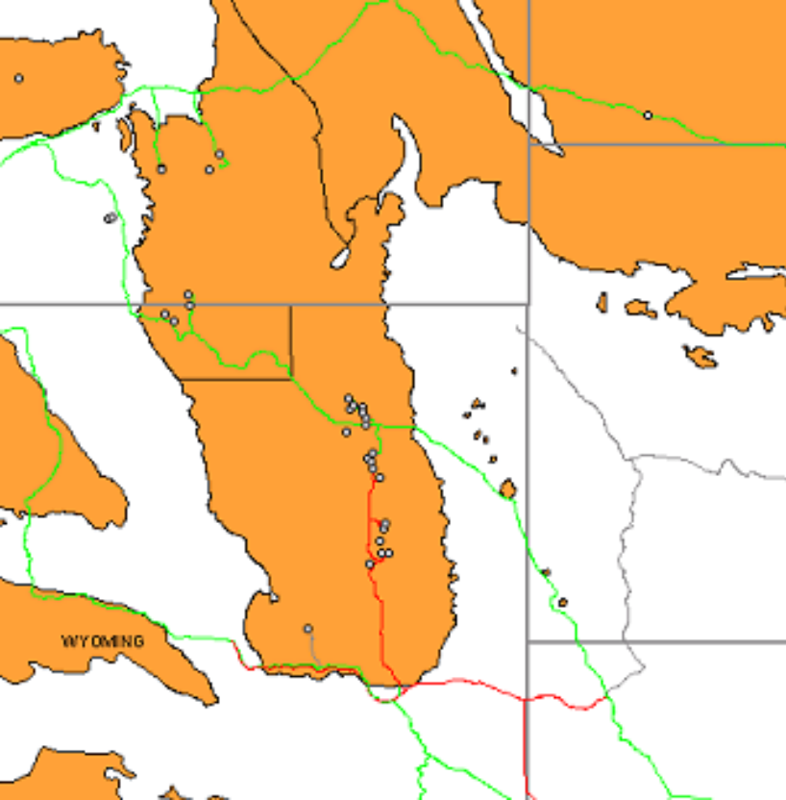
Powder River Basin – A Third of the Nation’s Coal
Est’d 2002 Production: over 380 million tons
Est’d 2002 US Production: 1132 million tons
Maps from RDI PowerMap

Slide 7
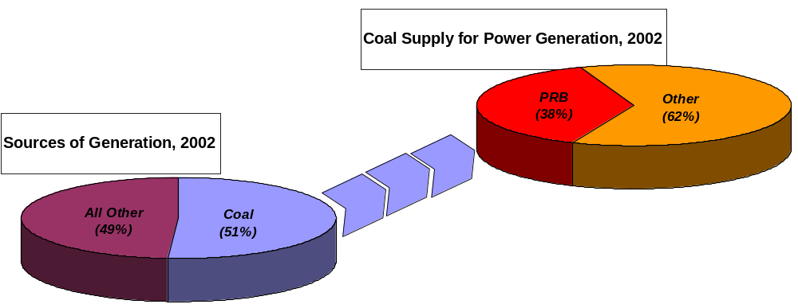
The PRB Supplies Over a Third of Coal for Generation
Source: EIA, STEO

Slide 8
The Rail Industry – Running into a Dead End?

Slide 9
State of the Railroads
  Staggers Act of 1980 was intended to save the rail industry through partial deregulation.
  Rail industry today is far healthier than 21 years ago.
  The railroads have pursued several paths to financial success:
    Cost-cutting and productivity improvements
    Merger
    Differential pricing
    Diversification
    New Services
    Investment

Slide 10
Several of the Key Railroad Business Strategies of the Past 21 Years Have Run Out of Steam
  Diversification is being abandoned by the carriers.
  Cost cutting may be reaching a point of diminishing returns.
  The mergers have not proved to be the ticket to financial success:
    UP with Chicago North Western: 1995
    BN with Santa Fe: 1996
    UP with Southern Pacific: 1996
    CSX and NS division of Conrail: 1999

Slide 11
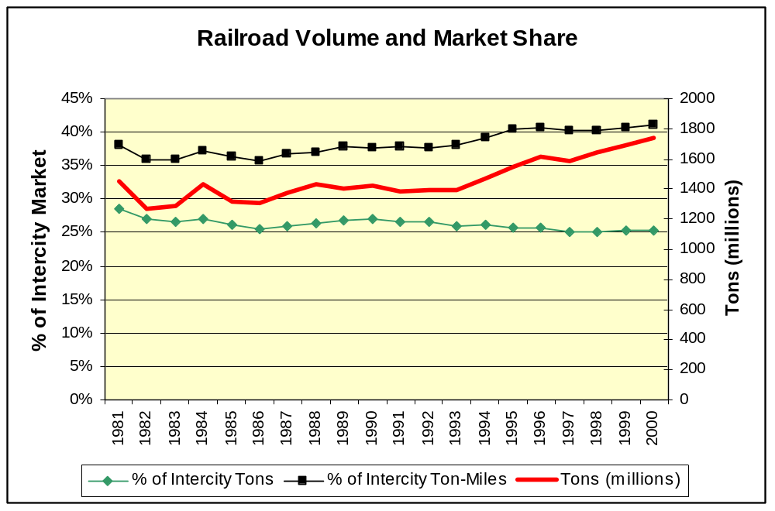
Growth has Been Elusive…
Source: AAR, 10-Year Trends and web site

Slide 12
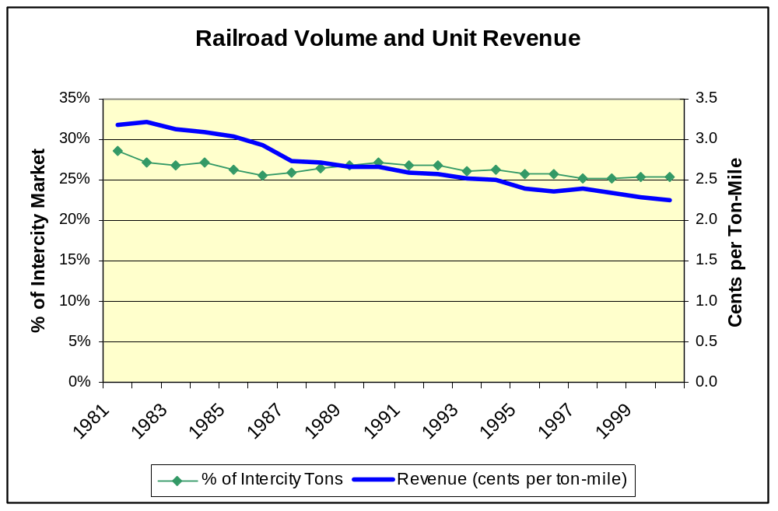
… and Unit Revenues Have Been Declining
Source: AAR, 10-Year Trends and web site

Slide 13
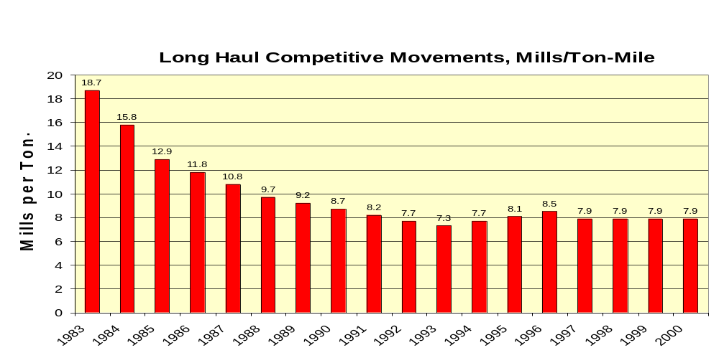
Rate Trends for PRB Movements
Source: PA Consulting Estimates

Slide 14
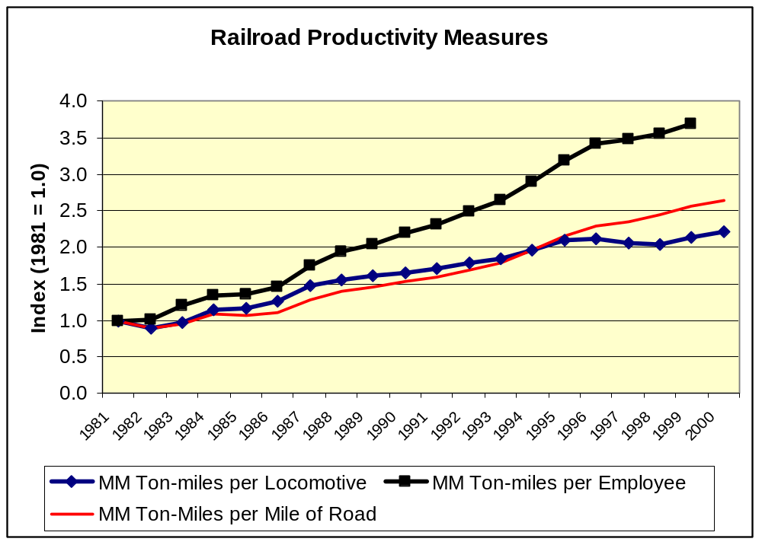
Productivity Gains are Beginning to Flatten
Source: AAR, 10-Year Trends and web site

Slide 15
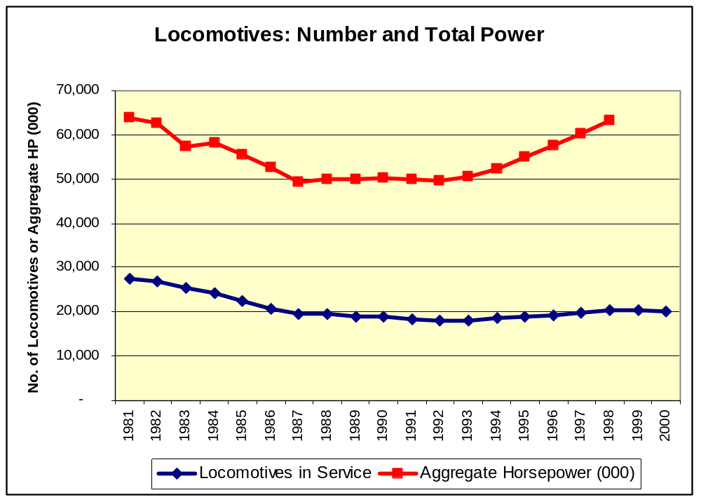
Increased Commitment of Resources
Source: AAR, 10-Year Trends and web site

Slide 16
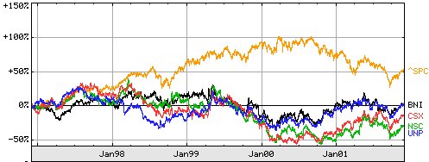
Railroads: Share Value has Lagged the Market

Slide 17
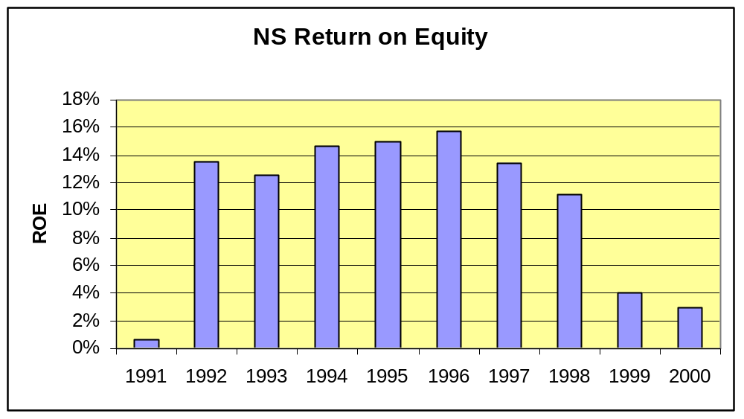
Impact of the Conrail Breakup -- NS
Conrail

Slide 18
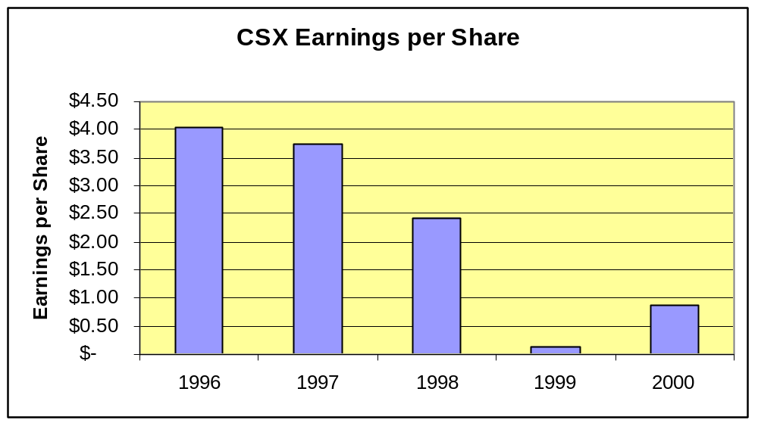
Impact of the Conrail Breakup -- CSX
Conrail

Slide 19
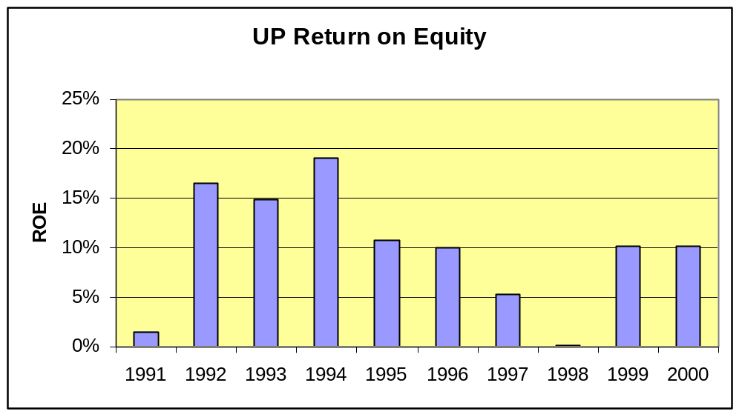
UP After Two Acquisitions
CNW
SP

Slide 20
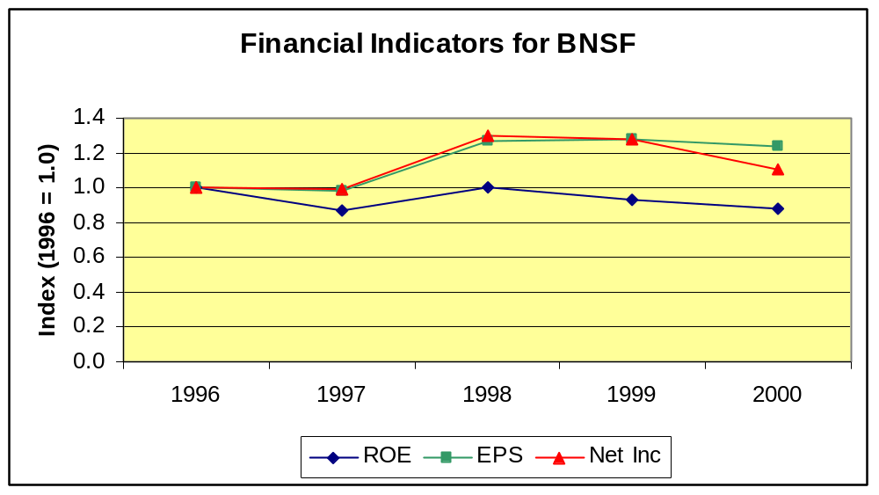
BNSF: Avoided Disaster, But Growth is Elusive

Slide 21
Railroad Business Strategy

Slide 22
Now What?
    Cost-cutting and productivity improvements
    Merger
    Differential pricing
    Diversification
    New Services
    Investment

Slide 23
“Yield Management”
  Another catch phrase is “charging rates that reflect the value of the service.”
  Translation: rate increases.
  This has been pushed by Wall Street, and is a common strategy element for the Big Four.

Slide 24
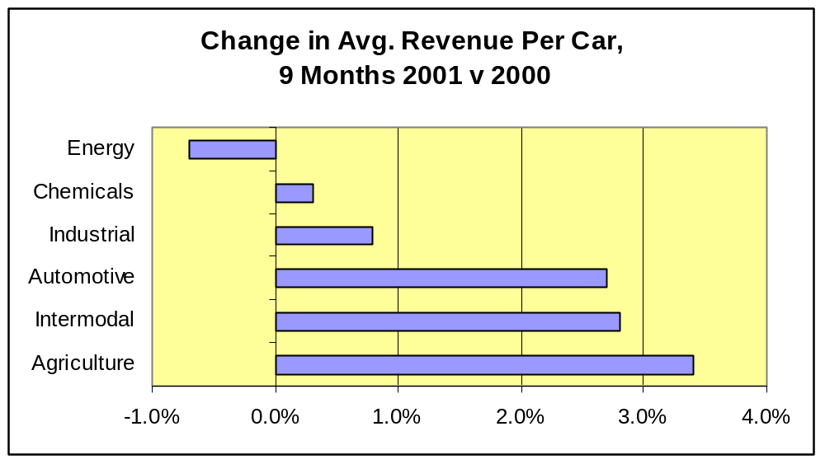
Yield Management -- UP

Slide 25
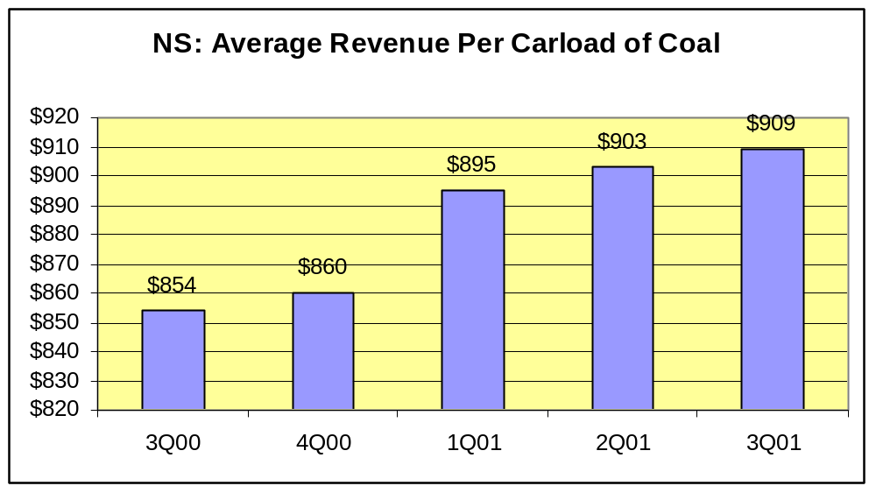
Yield Management -- NS

Slide 26
Capturing Value -- BNSF
  From remarks made by BNSF President Matt Rose at Salomon Smith Barney, November 5, 2001:
    Clear that cost-cutting alone will not produce financial success. A new, more balanced business strategy is needed.
    Elements of balanced strategy: greater efficiency, greater volume, and higher rates (made possible by improved service and elimination of excess capacity).
    Long-term, confidential rail contracts have contributed to low coal pricing by obscuring price signals. More transparent pricing will help to encourage rate increases – this is one goal of the BNSF’s coal transportation options auctions.
    Decline in rail rates for coal must stop. Rates should reflect value of service.

Slide 27
Growing the Top Line – New and Improved Services
  Much of the focus is on improved intermodal and other truck-competitive services.
  Object in part is to win back business lost to trucks due to merger problems, and in part to expand market share.
  Even a small shift in market share from trucks would yield enormous benefits to the railroads:
    For example, in the western US the Union Pacific estimates the total size of the potential market at $90 billion, of which trucks control 78%
    Each percent of market share would boost revenues by almost $1 billion

Slide 28
UP’s “Blue Streak”
  High-speed intermodal service from LA to Atlanta.
  Seamless service via an alliance between UP and NS.
  Three levels of service and pricing:
    SuperFlyer: on-time or free
    Premium: priority call on train space and other services
    Standard: capacity available to price sensitive customers as available.

Slide 29
Key Characteristics of Premium Services
  Generally aimed at trucks.
  Essential elements are speed, certainty, and consistency.
  Object is to convert a commodity service into a differentiated product that will attract new business at profitable rates.

Slide 30
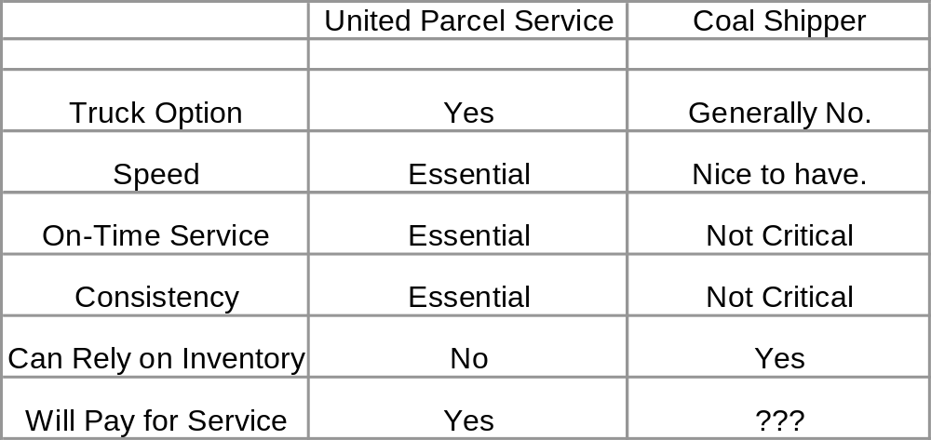
Who Needs Top-Flight Service?

Slide 31
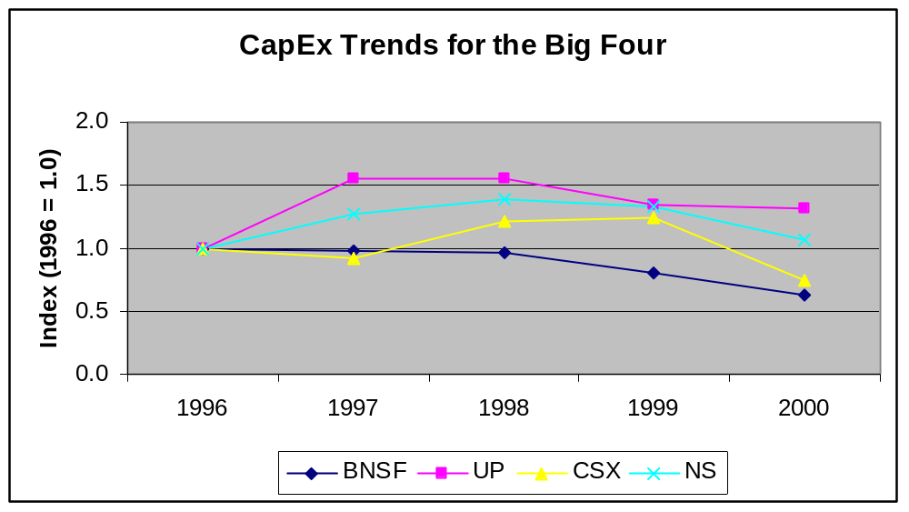
Who Will Get the Money?

Slide 32
Implications for Coal and Power

Slide 33
The Path not Taken? (1)
  Market and Cooperative Solutions to Increasing Capacity at a Low Capital Cost:
    Rationalize the allocation of railroad capacity to reflect buyer’s willingness to pay
    Give railroads flexibility to allocate private rail fleets to meet system needs.
  Examples Include:
    Seasonal pricing
    Pricing tied to service quality
    Auctions of blocks of railcar capacity
    Railcar pooling

Slide 34
The Path not Taken? (2)
  Some market-based innovations have been tested, but generator response has been tepid, and the railroads move at a glacial pace.
  The strategic focus of the railroads – concentrate on truck-competitive traffic, cut capital investment even as demand grows, and push to increase rates – is a formula for confrontation, not cooperation.

Slide 35
Implications (1)
  Coal service will continue to take a lower priority to intermodal and other truck-competitive, time-sensitive services.
  In an effort to increase ROI and placate Wall Street, the railroads will seek to minimize CapEx, and will focus available funds on truck-competitive growth opportunities and high-value targets (e.g., chemical business). This does not bode well for coal shippers.

Slide 36
Implications (2)
  The railroads have been unable to consistently provide a reasonable level of service. Tight rationing of investment dollars increases the likelihood of future service disruptions.
  Bad service is more than an inconvenience. In the worst case, generators have had to back-down coal plants and use gas plants or purchased power to meet commitments – this can get very expensive very fast, and can undermine system reliability
  Captive shippers are also likely to face aggressive efforts by the railroads to increase rates.

Slide 37
Implications (3)
  At a minimum, the current railroad business strategy is unfavorable to coal-burning utilities, and is likely to lead to increased contention over rates and service.
  Contention will be inimical to cooperation and joint innovation, which will inhibit steps that could improve reliability or decrease costs.
  The increases concentration in the rail and power industries may increase the possibility that a misstep by a few key players could play havoc with coal service, generation reliability and costs.

